Slide 1
PERSONAL BLOG

Slide 2
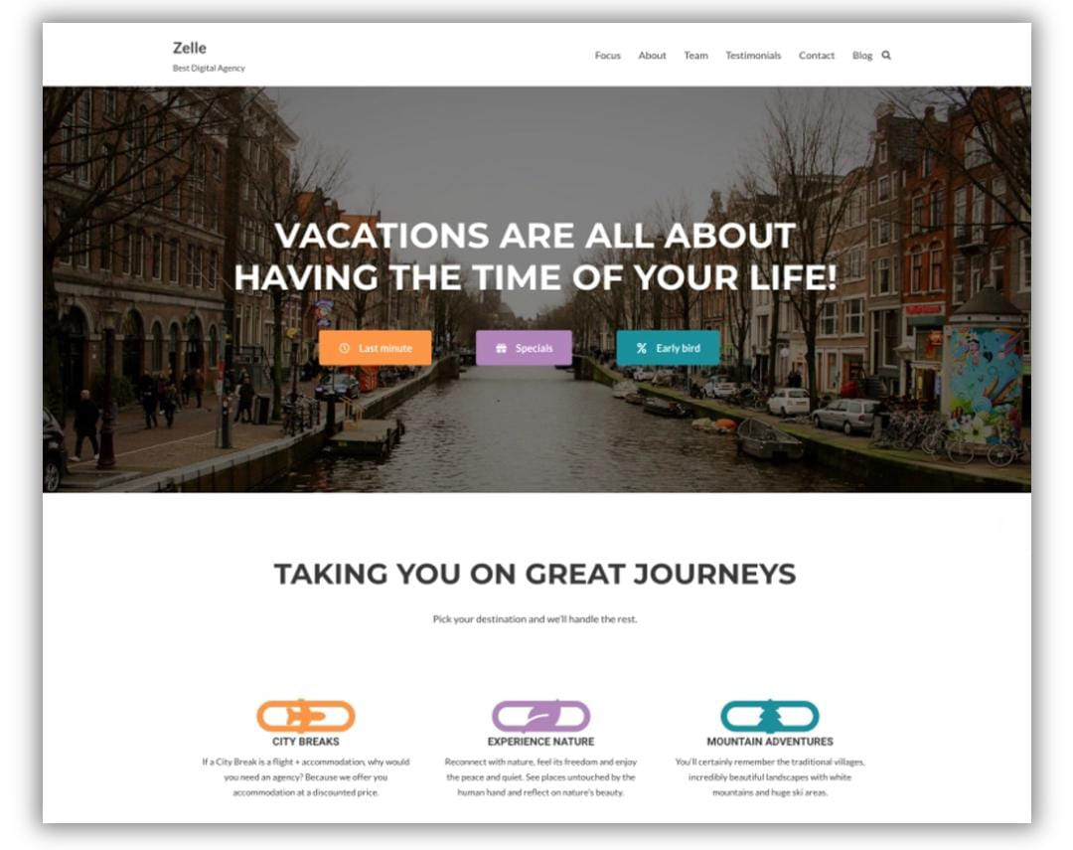
GUIDE TO WRITING A TRAVEL BLOG
1: Start with Research. ...
2: Choose a Niche. ...
3: Choose a URL and Create Your Website. ...
4: Start Networking within the Travel Industry. ...
5: Continue to Travel, Journal, and Add New Posts
on a Regular Basis. ...
6: Cultivate Engaging Posts.

Slide 3
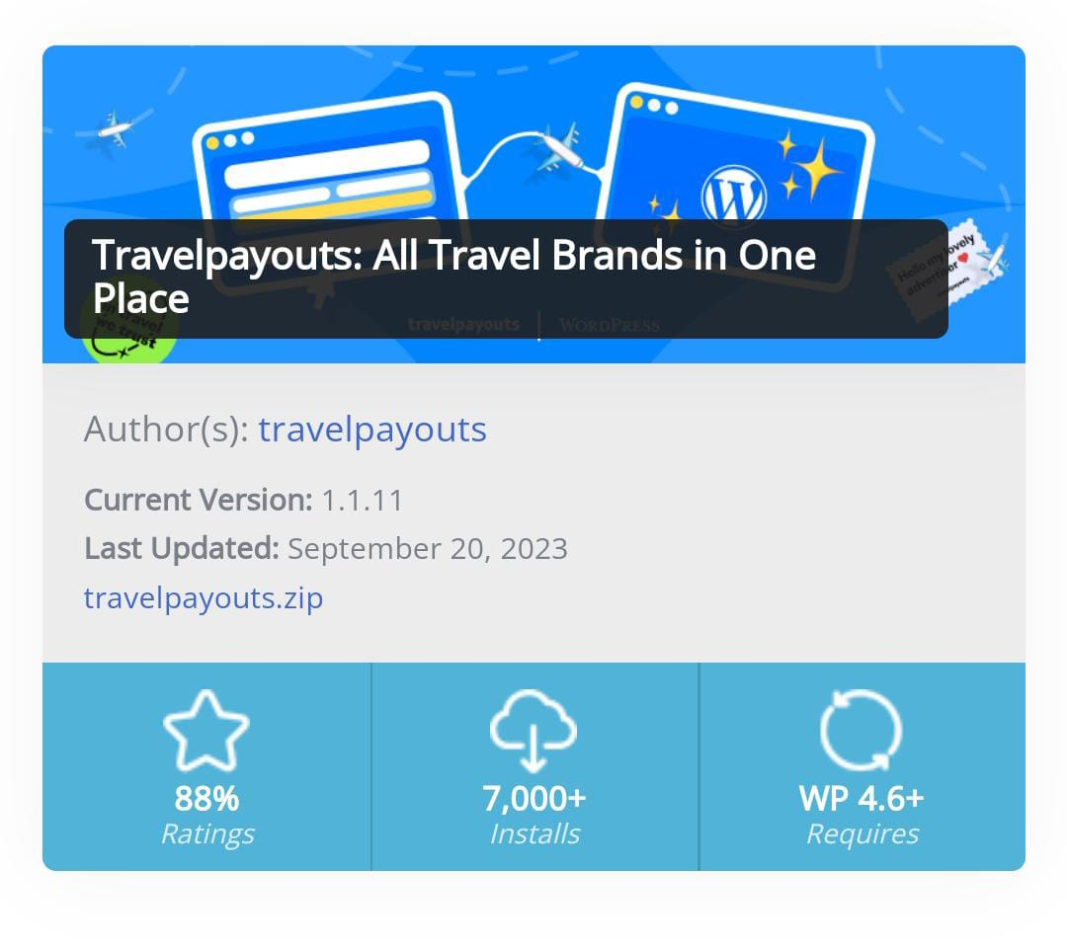
HOW TO WRITE A PERSONAL BLOG
Step 1: Plan your blog post by choosing a topic, creating an outline, conducting research, and checking facts.
Step 2: Craft a headline that is both informative and will capture readers’ attentions.
Step 3: Write your post, either writing a draft in a single session or gradually word on parts of it.
Step 4: Use images to enhance your post, improve its flow, add humor, and explain complex topics.
Step 5: Edit your blog post. Make sure to avoid repetition, read your post aloud to check its flow, have someone else read it and provide feedback, keep sentences and paragraphs short, don’t be a perfectionist, don’t be afraid to cut out text or adapt your writing last minute.

Slide 4
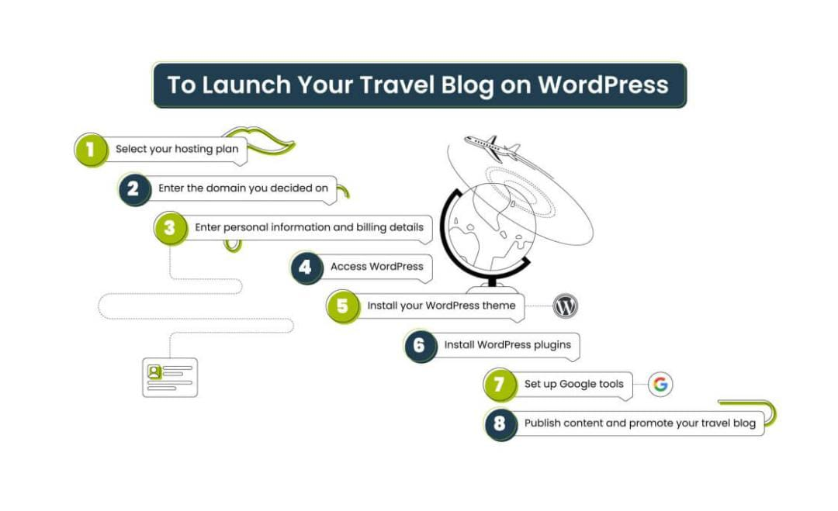
ELLABRATION OF THIS STEPS
Start with Research
Before you begin writing any of your content, or even selecting the name of your travel blog, you must invest some time in research. The best place to begin is by looking at the most popular travel blogs at the moment. Pay particular attention to travel bloggers who have achieved long-term success, as well as the newer travel bloggers who are quickly gaining momentum.Take notes to highlight what the high-ranking travel blogs have in common, and what makes them stand out as different. This includes features such as the page layout, writing style, use of images, and video. The goal is not to copy what other bloggers are doing – but to see what works and what doesn’t, and for overall inspiration.

Slide 5
Choose a Niche
One thing you will notice when researching the most popular travel blogs is that
they all have a niche that they cater to. Sometimes the niche is obvious,
such as an adventure travel blog or budget travel blog, but sometimes
it will be more understated than that. For example, a travel blog geared towards
professional women in their mid-30s is an example of a very specific niche.
Selecting a niche is essential for everything, from keywords to the URL,
writing style, and how to incorporate images. Being hyper-focused on a niche is also important if you want your travel blog to gain the attention of travel companies or brands, so they can gauge how well your blog speaks to their target audience.

Slide 6
Choose a URL and Create Your Website
Before you begin writing a travel blog, you must first select a URL and build the website. Not as easy as it sounds! It is getting harder to find good URLs that are short, catchy, and contain keywords relevant to your target audience. A clever and memorable arrangement of two to four words is about right. Chances are you will need to go for a more unique combination and maybe even include your name in the URL. Whether you outsource your blog design or build your own blog on sites like Wix or WordPress, make sure it reflects your unique personality and travel journey. Take care that the layout is visually appealing and easy to read, and of course, looks great on mobile.

Slide 7
Start Networking within the Travel Industry
Once your travel blog is up and running and you’ve published your first few posts, it’s time to begin networking. The primary places you want to focus your networking efforts are with your target audience and travel professionals.

Slide 8
Travel brands & professionals
Start by researching the most relevant brands, sponsors, journalists, and PR companies in your travel niche. Try to get specific names and contact information for the travel professionals you find – and reach out via email or social media DM to introduce yourself. The goal is to build a mutually beneficial relationship in which you blog to their benefit – in exchange for travel perks and other payments.If possible, try to meet them in person. If the last few years of COVID Zooming have taught us anything, it’s that there is no substitute for face-to-face interaction. If the contact is not in your local area, then Zoom is the next best thing. Try to meet in person next time you are traveling in their area.Continue to check in regularly to create an ongoing relationship with your monetization partners, and follow up after every meeting.Don’t let the size or scale of the travel brands or companies you source discourage you from reaching out. While PR companies do their own analytics to help determine which travel bloggers to call, it is your responsibility to take control of your success.

Slide 9
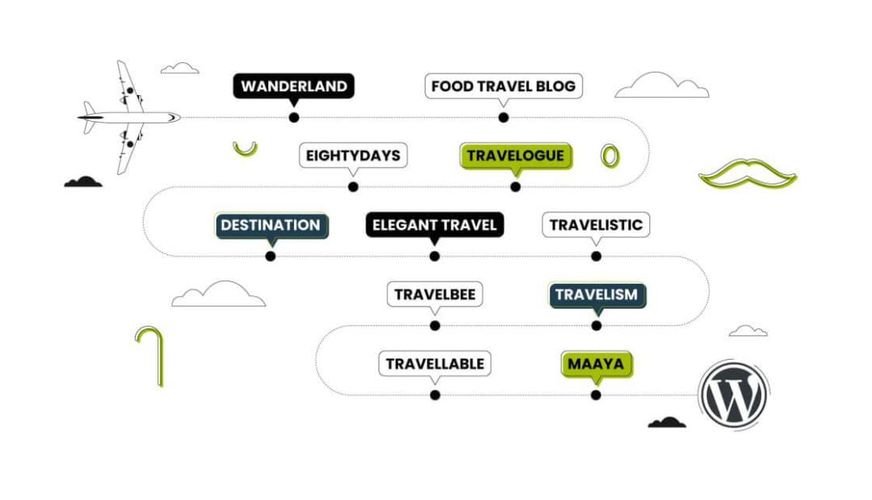
Travel bloggers
While you should connect with other travel bloggers on social media, also look for opportunities to connect with them in person and build F2F relationships. This is beneficial when it comes to guest blogging opportunities and referrals for travelers outside of their niche, and they may even be willing to provide some invaluable tips and tricks.Offer to feature their sponsored posts on your blog; this can be a great tactic to draw the attention of a travel industry professional or brand who knows the other blogger but isn’t yet acquainted with your blog.

Slide 10
Social media
Social media will play an essential role, both in marketing your travel blog to readers and networking with others within the travel community. Friend and Follow as many travel professionals as you can find, and post consistently to help gain more followers in your niche – and to show travel professionals your level of dedication, and ability to generate attention.

Slide 11
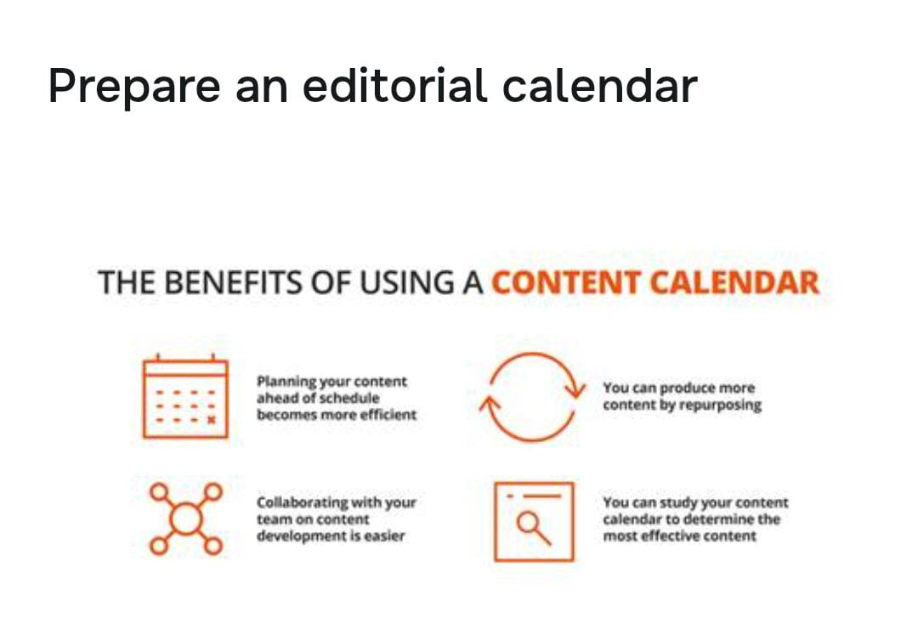
Continue to Travel, Journal, and Add New Posts on a Regular Basis
A critical ingredient when it comes to writing a travel blog is traveling frequently enough to have something new to blog about. So that you can fully enjoy your travels, and have new materials for your blog, begin a travel journal that you can refer back to when writing your blog posts when you return home.The structure of your posts can vary; you could break them down by “Day 1 in Florence”, Day 2 in Florence”, etc., or you can post by specific topics such as “Food”, “Sights”, or “Rooms.” Set a goal to post several articles about each travel location, and feel free to spread them out over a week or two
To boost your SEO, infuse your posts (without overdoing it) with well-researched keywords – and keep an eye on what percentage of your traffic comes from keywords, social media, and paid traffic.

Slide 12
Ensure that posts include the specifics that your readers are looking for, such as:
Names of restaurants, cafes, hidden gems
Details about what you booked or ordered
Name of the company or website you booked on
Name and address of hotel/accommodation
Available transport options
Price ranges for all activities
What to wear/ what to pack
What time of year you traveled
Unique tips and tricks you discovered along the way
While it is essential to post consistently, you may not be traveling at all times. Posts in-between travel can be geared towards general travel tips, niche-specific travel tips, or some of your favorite travel locales or travel stories.

Slide 13
Cultivate Engaging Posts
Writing a travel blog will require you to do more than share general travel information, or post about your daily itinerary. In order for readers to find your blog valuable, and keep coming back, it must be both informative and engaging, and bring a perspective that is fresh, unique, or otherwise different than all the other travel blogs out there. Here are a few tips to make your blog more engaging.

Slide 14
Writing style
Writing a travel blog is a personal experience, so you have much freedom when it comes to the tone of your writing. Write in a way that reflects your authentic voice and viewpoint. Include humor if you like, or a different perspective, and you can even share controversial opinions to get the buzz going.

Slide 15
Images and video
The goal of your blog is to inspire your readers, and get them excited about travel – and images and video are a must to achieve this. Consider investing in a high-quality camera or make sure your smartphone has a blog-worthy camera. Your blog posts should include images and videos of the area you are blogging about – the more, the better!

Slide 16
Explore Multiple Strategies for Monetizing Your Blog
The last few steps have focused on the ways in which you can make your blog stand out by being engaging and visually appealing, which translates into more new traffic, and more repeat traffic. The more traffic to your blog, the more opportunities you have for monetization. While your number one target audience for monetization should be travel industry professionals, also consider:

Slide 17
Google AdSense and other PPC options
Native advertising Become an affiliate for travel-related products and businesses Besides the tips above, you will need to aggressively promote your blog and build up a subscriber community to boost page views and engagement and gain the attention of potential monetization sources. Keep in mind the overall user experience, which should be entertaining, informative, tempting, and satisfying. The steps above will help you to achieve this. As your visitors continue to flock to your site with regularity, brands and sponsors from the travel industry will soon follow.

Slide 18
Key Takeaways
● There are different kinds of blog types that you can choose from for your blog like listicles, write travel guides, write about your city, things to do in lists, suggest itineraries, travel blogging tips, interviews, etc.
● Prepare an editorial calendar for content marketing purposes that will help you research, write and publish blog posts according to the timeline prepared by you.
● Keyword research is important before you start blog writing on travel, and various tools can help you research relevant keywords, related keywords, and topics for a blog.
● Prepare an overview of the blog before you start writing.
● Good quality pictures speak a lot about the location, the surrounding, and the little elements in the picture and help attract the audience.
● There are several tools available online that will be great at assisting you to run your travel blogs, such as Grammarly, Canva, SEMrush, MailChimp, and Pinterest

Slide 19
Conclusion
Travel blogging starts as a hobby for most people, but only a few know how to monetize it. You can become a successful travel blogger if you have a passion for it and can write your experiences in a way that makes people fall in love with traveling.

